Slide 1

https://bit.ly/3MXxL1g

Slide 2
#Fcuk
Cancer

Slide 3
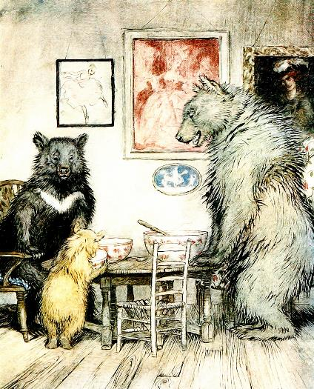
Goldilocks and the three business bears;
story telling for business
Notes:
https://publicdomainpictures.net/en/view-image.php?image=194409&picture=the-three-bears

Slide 4
https://bit.ly/3MXxL1g

Slide 5
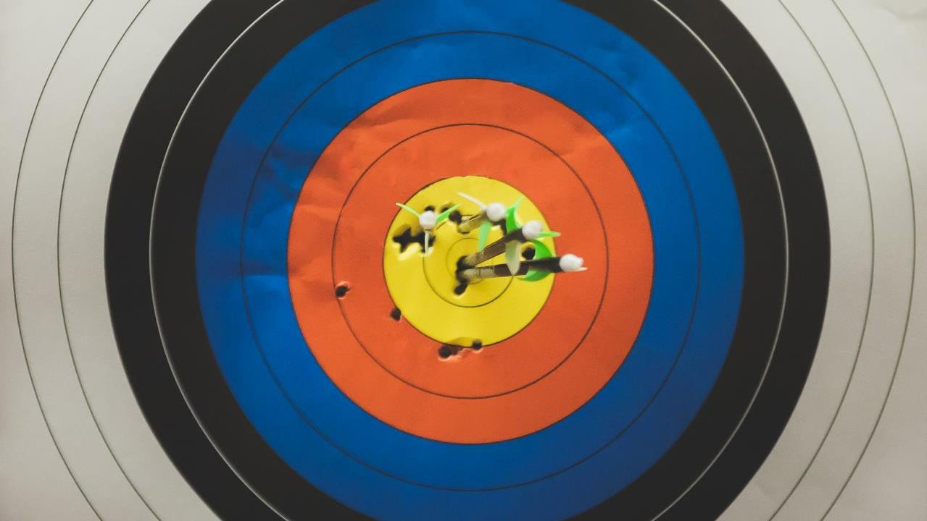
Notes:
Photo by Kenny Eliason on Unsplash
What is my goal today?

Slide 6

Notes:
Photo by Elevate on Unsplash
To give people a flavor of several topics

Slide 7

Notes:
Photo by Markus Winkler on Unsplash
Before I start I want to discuss some opinions people have

Slide 8

Notes:
Photo by Markus Winkler on Unsplash
Some people like to share their opnion

Slide 9
Storytelling has no place in business

Slide 10

Notes:
Photo by Pixabay: https://www.pexels.com/photo/question-mark-on-chalk-board-356079/
A few questions

Slide 11
In 2019 which industry generated > $100 billion
Notes:
https://www.forbes.com/sites/rosaescandon/2020/03/12/the-film-industry-made-a-record-breaking-100-billion-last-year/?sh=6e0e82434cd6
Entertainment market

Slide 12

Notes:
Photo by Martin Lopez: https://www.pexels.com/photo/man-holding-clapper-board-1117132/
The entertainment industry

Slide 13

Notes:
Photo by Susan Wilkinson on Unsplash
What about fiction books

Slide 14
People do not buy goods and services.
They buy relations, stories and magic.
Seth Godin
Notes:
Some people disagree with this opinion

Slide 15
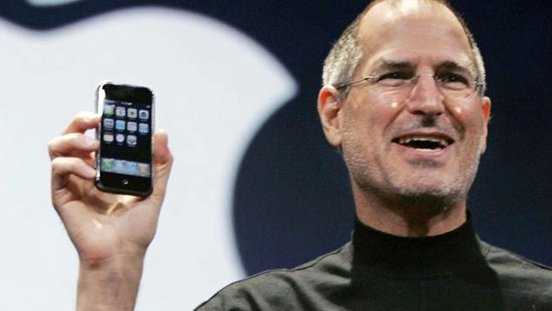
Notes:
https://www.flickr.com/photos/kimstovring/15670878201
Steve Jobs would have probably agreed with the previous statement

Slide 16
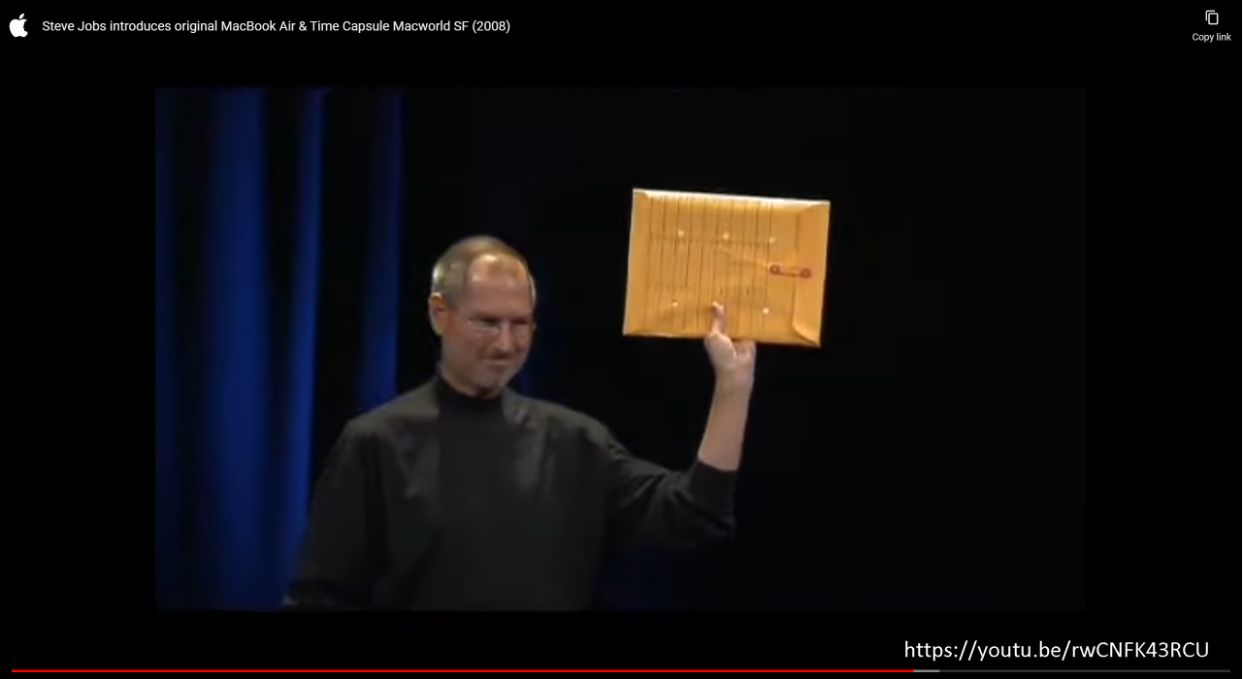

Slide 17

Notes:
https://www.maxpixel.net/Apple-Iphone-8-Smartphone-Apps-Application-App-3d-4389881

Slide 18
Data stories don't change peoples’ minds

Slide 19

Notes:
Photo by Mikael Seegen on Unsplash
This next section is a little controversial

Slide 20
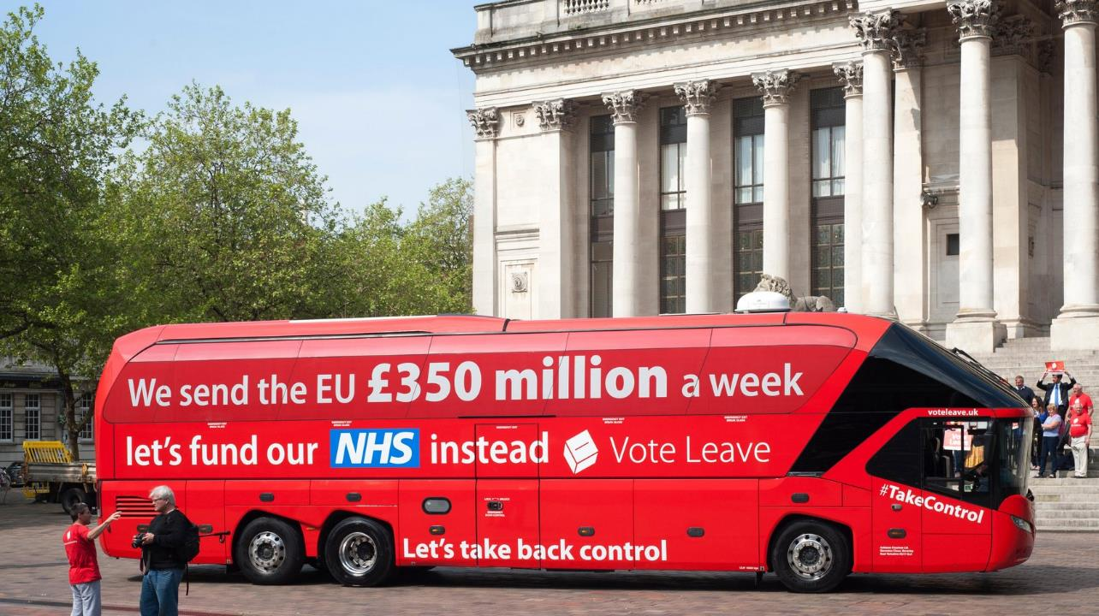
Notes:
Ordered by:- rwlp.french@gmail.com
Order reference- OY67246107

Slide 21
Story
Notes:
Ordered by:- rwlp.french@gmail.com
Order reference- OY67246107

Slide 22
Story
Data
Notes:
Ordered by:- rwlp.french@gmail.com
Order reference- OY67246107

Slide 23
Story
Data
Narrative
Notes:
Ordered by:- rwlp.french@gmail.com
Order reference- OY67246107

Slide 24
Story
Data
Narrative
Call to action
Notes:
Ordered by:- rwlp.french@gmail.com
Order reference- OY67246107

Slide 25

Notes:
There is more

Slide 26
“…Two-thirds of leave supporters still believe the discredited claim that the UK sends £350 million per week to the EU, compared with only one in five remain supporters……"
(from "The Perils of Perception: Why We’re Wrong About Nearly Everything" by Bobby Duffy)
Notes:
Discredited
Debunked
Refuted
Rejected
Discarded
Shamed
Disgraced

Slide 27





Robert French
Chief Power BI Nerd at Quorum
Lives in Sunny Glasgow, Scotland
rwlp.french@gmail.com
@sqlbobscot
https://www.linkedin.com/in/rwlpfrench/
https://www.qnrl.com/

Slide 28

Managed Services | Projects & Professional Services
Modern Workplace Secure Remote Work
Productivity & Teamwork
Security & Governance
Cloud
Platform Adoption & Migration
DevOps Engineering
Cloud Innovation
Data, Analytics & AI Data Platform
Business Intelligence
AI and Machine Learning
Business Apps & Development
Power Platform
Application Modernisation
Cloud Development
Security, Compliance & Identity Identity as a Service | Multi-Factor Authentication | Device Management | Threat Management | Information Protection | Application Security
Strategy | Architecture | Design | Engineering | Testing | Deployment | Operations
Supporting your business through our technology solutions
DevOps | Agile | Business Change | Project Management | User Training & Education

Slide 29


Slide 30


Slide 31
https://bit.ly/3MXxL1g

Slide 32

Notes:
Photo by Francesco Ungaro: https://www.pexels.com/photo/aircraft-flying-over-snowy-forest-in-morning-6105980/
This session is not going to in depth its going to be an overview of various topics

Slide 33

Notes:
Photo by Fernando Rodrigues on Unsplash

Slide 34

Notes:
Photo by Ann H: https://www.pexels.com/photo/pink-jigsaw-puzzle-piece-3482441/
There are going to be some gaps in what I want to talk – next slide

Slide 35

Notes:
Photo by Maria: https://www.pexels.com/photo/clear-hour-glass-on-golden-frame-5357088/
AS I do not have time

Slide 36


Notes:
Photo by Content Pixie on Unsplash
First we are going to talk about stories,
How they affect you, how they are constructed, and what makes a good story

Slide 37


Notes:
Photo by Wan San Yip on Unsplash
Who is your audience

Slide 38


Notes:
Photo by Mika Baumeister on Unsplash
Data

Slide 39

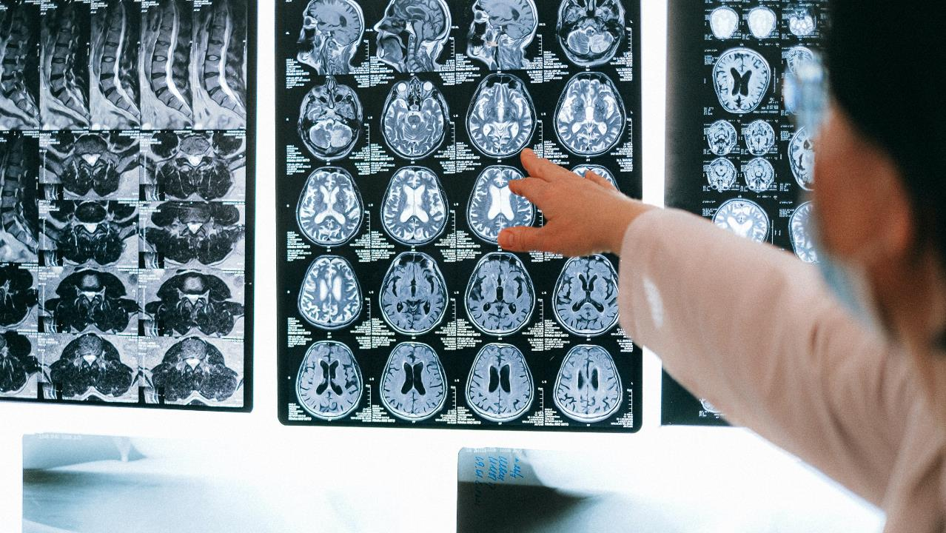
Notes:
Photo by Anna Shvets: https://www.pexels.com/photo/person-holding-silver-round-coins-4226264/
Look at how the brain works consider psychology and physiology

Slide 40

Notes:
Photo by Andrea Piacquadio from Pexels

Slide 41
Notes:
Photo by Content Pixie on Unsplash
First we are going to talk about stories,
How they affect you, how they are constructed, and what makes a good story

Slide 42

Notes:
First part of the workshop we are going to talk about stories and story telling looking a the nuts an bolts so to speak

Slide 43
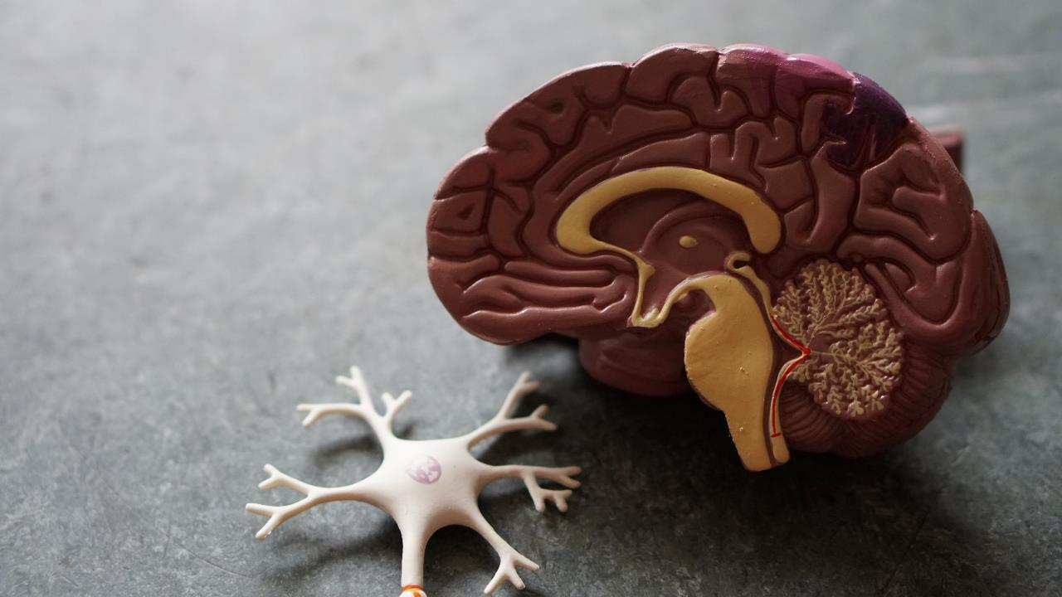
Notes:
Look at how the brain sees and things about things
Photo by Robina Weermeijer on Unsplash

Slide 44
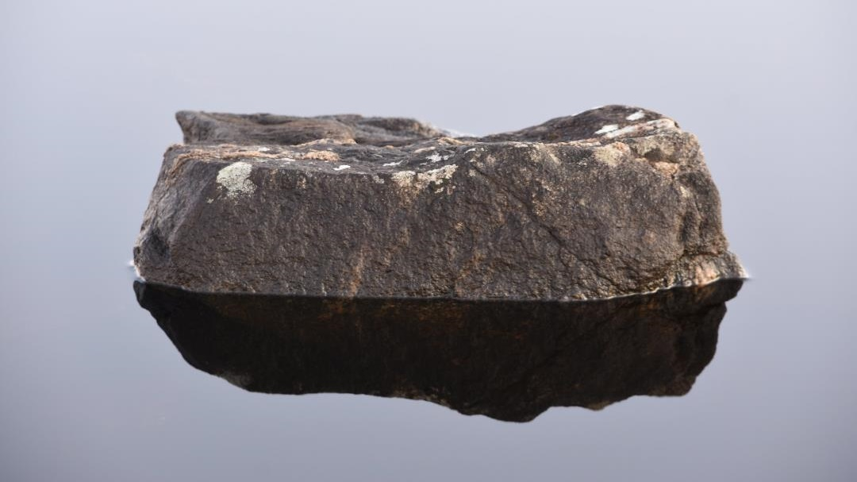

Slide 45
What happens when you hear or read a story?

Slide 46

Stories
E.g. Books, Films, TV, Audiobooks, etc
They cause oxytocin to be released. (feel good hormone)
Notes:
When we hear stories or have stories read to us, watch a film, or a TV programme like a soap opera or a crime drama
It releases Oxytocin this the same hormone release when we are cuddled or in love,
It make us feel good

Slide 47

Notes:
As the writer describes how the person touching the water, the feeling of how it joins to the fingers, that cooling sensation. You feel it as well
Photo by Chris Leipelt on Unsplash

Slide 48

Notes:
Stories can make our heats beat faster just by being part of the story

Slide 49

Notes:
We get caught up in the emotion of the story

Slide 50
Stories can make us…….
Feel emotions?
See the scenes in our minds eye?
Hear what is described?

Slide 51

Notes:
Lets have a simple story
So get comfortable and I’ll begin
Photo by mentatdgt from Pexels

Slide 52

Notes:
Photo by cottonbro studio: https://www.pexels.com/photo/man-in-black-jacket-using-macbook-pro-4064848/

Slide 53

Notes:
Photo by Sergei Starostin: https://www.pexels.com/photo/network-servers-on-an-enclosure-6466141/

Slide 54

Notes:
Photo by Miguel Á. Padriñán: https://www.pexels.com/photo/close-up-shot-of-keyboard-buttons-2882553/

Slide 55


Slide 56

Notes:
Photo by Andrea Piacquadio: https://www.pexels.com/photo/mad-formal-executive-man-yelling-at-camera-3760790/

Slide 57

Notes:
Photo by Inzmam Khan: https://www.pexels.com/photo/man-in-black-shirt-and-gray-denim-pants-sitting-on-gray-padded-bench-1134204/

Slide 58

Notes:
Photo by Gustavo Fring: https://www.pexels.com/photo/man-using-laptop-in-office-4975660/

Slide 59

Notes:
Photo by Christian Buehner on Unsplash

Slide 61

Notes:
Photo by CHUTTERSNAP on Unsplash

Slide 62
Notes:
Photo by Andrea Piacquadio: https://www.pexels.com/photo/mad-formal-executive-man-yelling-at-camera-3760790/

Slide 63

Notes:
Photo by DS stories: https://www.pexels.com/photo/minimal-image-of-a-scrabble-word-on-lilac-background-6005376/

Slide 64
Notes:
Photo by Andrea Piacquadio: https://www.pexels.com/photo/mad-formal-executive-man-yelling-at-camera-3760790/

Slide 65
Notes:
Photo by cottonbro studio: https://www.pexels.com/photo/man-in-black-jacket-using-macbook-pro-4064848/

Slide 66

Notes:
Photo by Andrea Piacquadio: https://www.pexels.com/photo/confused-businessman-checking-time-on-wristwatch-3760810/

Slide 67
100%
Complete

Slide 68

Notes:
Photo by Blake Wisz on Unsplash

Slide 69

Notes:
Photo by Toa Heftiba on Unsplash

Slide 70

Notes:
Photo by Pixabay: https://www.pexels.com/photo/two-teacups-on-machine-269126/

Slide 71

Notes:
Photo by Ann H from Pexels

Slide 72
Climax
Falling Action
Rising
Action
Resolution
Set up Intro to character
Notes:
So what did we have lets look a the story arc
For this story

Slide 73
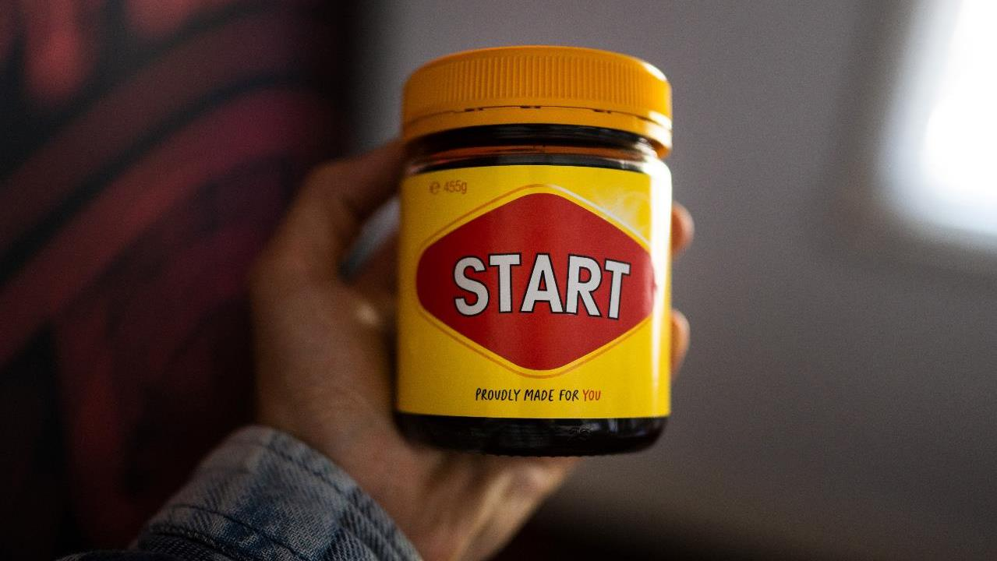
Beginning
Notes:
Photo by Start Digital on Unsplash
Every story has a beginning when we introduce the topic the story is about

Slide 74

Middle
Notes:
Photo by Andrea Piacquadio from Pexels
The messy middle when we start to explore the data that is going to show, or illustrate or highlight something we are going to talk about in the story

Slide 75

End
Notes:
Photo by Anton Shuvalov on Unsplash
This is the end, at this point we are telling the audience conclusions that should take from the story or the actions to take or not to take

Slide 76
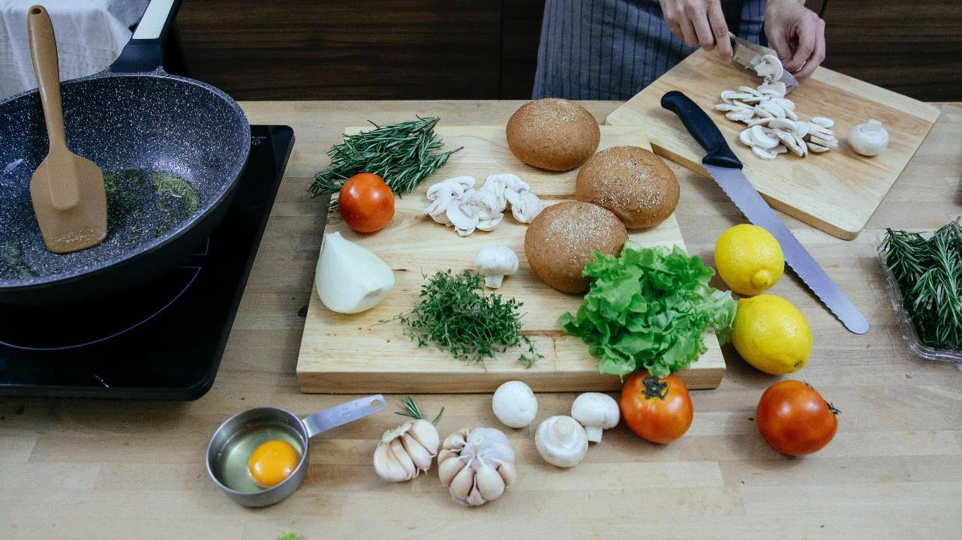
Notes:
What the ingredients for creating a good story
Lets look at them one by one
Photo by Katerina Holmes from Pexels

Slide 77
Beginning
Notes:
Photo by Start Digital on Unsplash

Slide 78
Set up the story
Problem?
Opportunity?
Discovery?

Slide 79
Who is the story's hero?
Who is the story’s mentor?

Slide 80
Remember who your target is?
The audience, are they the hero’s?
Or the data might be the hero you are revealing?

Slide 81
You are the hero’s mentor?
Yoda -> Luke
Alfred -> Batman
You guide them and help them realise their potential.

Slide 82
Middle
Notes:
Photo by Andrea Piacquadio from Pexels

Slide 83
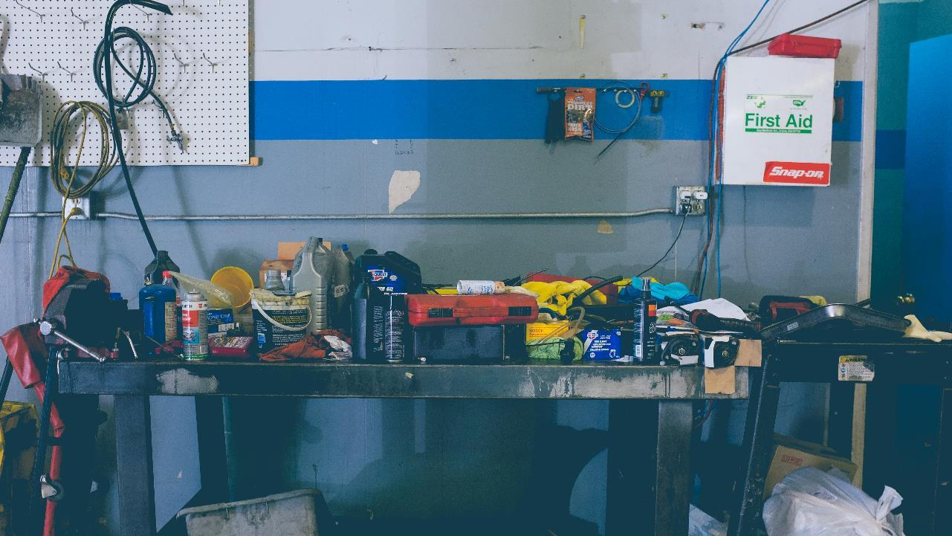
Notes:
Messy middle - this when you layout the show the audience what you are talking about
If it's about data this is when you share the data ☺
Photo by NeONBRAND on Unsplash

Slide 84

Notes:
Show the audience what you see
Photo by Antoine Boissonot on Unsplash

Slide 85

Notes:
Use the data to reinforce your points that you are making
Data is there to help you tell the story to underline the points you are making.

Slide 86
End
Notes:
Photo by Anton Shuvalov on Unsplash

Slide 87

Notes:
What's the call to action?
Photo by Jakob Owens on Unsplash

Slide 88

Notes:
What conclusion should they draw?
It’s the end of the story what should the audience take away?
Photo by Ann H from Pexels

Slide 89

Notes:
How can we use that in a Business Context?
How can these techniques actually be used in a business context?
Photo by Adeolu Eletu on Unsplash

Slide 90

Notes:
Lets just cut that up into sections, Acts if you like.
Photo by Adeolu Eletu on Unsplash

Slide 91
Act one – situation
Opportunity
Value of aluminium has increased significantly.
Challenge
Potholes claims costs increasing each year.

Slide 92
Act Two – complication
Opportunity
Not easy to access the metal in recycling bins
Analysis shows can generate a lot of money for council
Top 3 reclaimers are willing to invest in new processes
Challenge
Can now predict with 80% accuracy when will occur and where
Same sites consistently generate claims against the council
Resurfacing costs less than claims

Slide 93
Act Three – Resolution
Opportunity
Engaging with aluminium reclaiming, with creating income stream
Add to council positive environmental portfolio
Call to action – set up contract with 1st reclaiming company
Challenge
People living in city will see the proactive actions being taken by council
Reduce money spent on claims per year
Call to action – create dedicated road resurfacing crew

Slide 94

Other story arcs are available
Notes:
Other types of story arc are available – Pixar use the three part hero arc quite a bit
Photo by moren hsu on Unsplash

Slide 95

Notes:
Last but not least lets look at Narrative

Slide 96
Narrative
Stories
Data

Slide 97
Define
Narrative

Slide 98

What is the narrative of Little Red Riding Hood?
Notes:
Photo by Šárka Jonášová on Unsplash

Slide 99
Nice girls never listen to
or talk to strangers

Slide 100
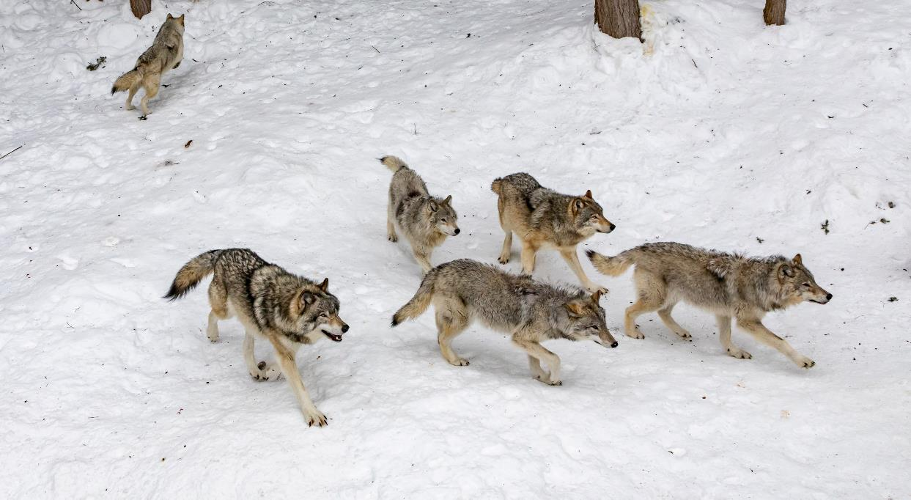
What is the narrative of The Boy Who Cried Wolf?
Notes:
Photo by Eva Blue on Unsplash

Slide 101
If you always lie people will stop believing you.

Slide 102
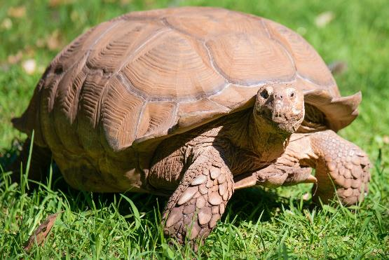
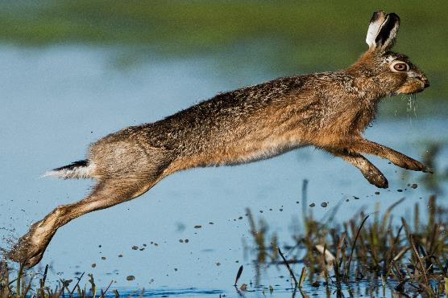
What is the narrative of The Tortoise and the hare?
Notes:
Photo by Joel M Mathey on Unsplash
Photo by Vincent van Zalinge on Unsplash

Slide 103
“Fast” is not always winning but “slow” and steady is winning in the end.

Slide 104


Slide 105
Notes:
Photo by Wan San Yip on Unsplash
Who is your audience

Slide 106

Notes:
What about sorting our audience into different categories?
Photo by Luis Quintero from Pexels

Slide 107

Notes:
Who might be comfortable with data in Glasgow City Audience?
Photo by Ari He on Unsplash

Slide 108

Notes:
Some people are very comfortable with numbers and lots of information
By NBC Television - http://www.ebay.com/itm/SUPERB-1968-Original-Photo-LEONARD-NIMOY-as-SPOCK-in-T-V-STAR-TREK-/261594177355?pt=LH_DefaultDomain_0&amp;hash=item3ce83a5f4b, Public Domain, https://commons.wikimedia.org/w/index.php?curid=35441204

Slide 109
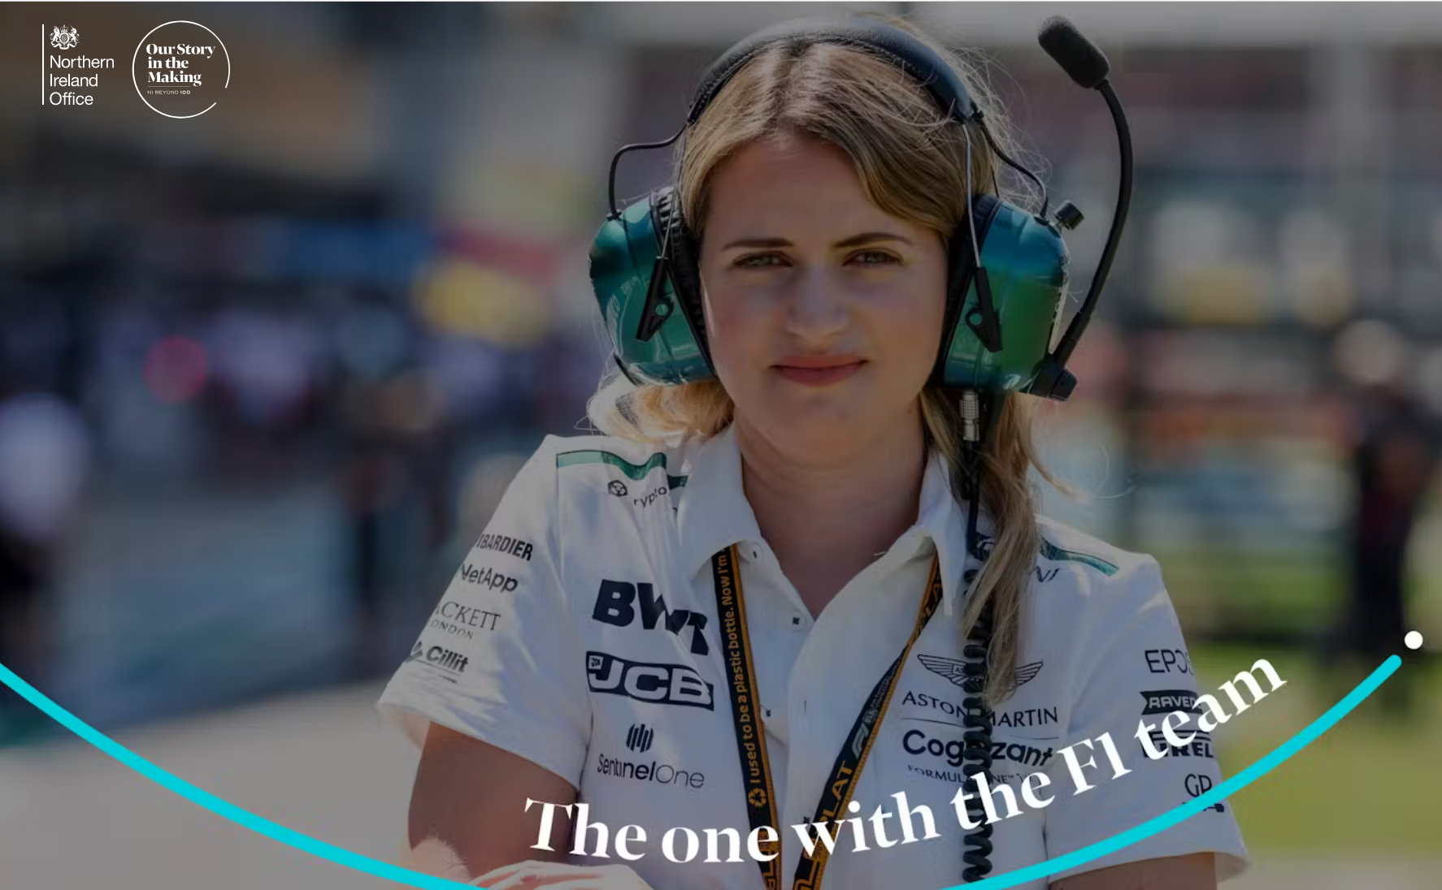
https://ourstoryinthemaking.com/stories/the-one-with-the-f1-team
Notes:
Bernadette (Bernie) Collins
Was Strategy Engineer for Aston Martin F1 team

Slide 110

Notes:
Who is uncomfortable with numbers
Photo by Nik Shuliahin on Unsplash

Slide 111

Notes:
Who is the audience
What are their data literacy levels
Are they a maths graduate
Background in Local government finance
F1 racing mechanic
Meet the inspirational women proving that F1 is ‘more than a man’s world’ (marieclaire.co.uk)
12 Top Car Racing Drivers That Happen to Be Women: 24 Hours of Daytona - Bloomberg
Artist with dyslexia
Photo by RF._.studio from Pexels

Slide 112

Notes:
Thinking of my parents and my partner Jan, none of them that data literate. Which only means the way that data is presented should be different.

Slide 113
205 %
more cyclists traveling into Glasgow city centre.
When compare 2009 with 2018.
https://www.understandingglasgow.com/indicators/transport/cycling

Slide 114
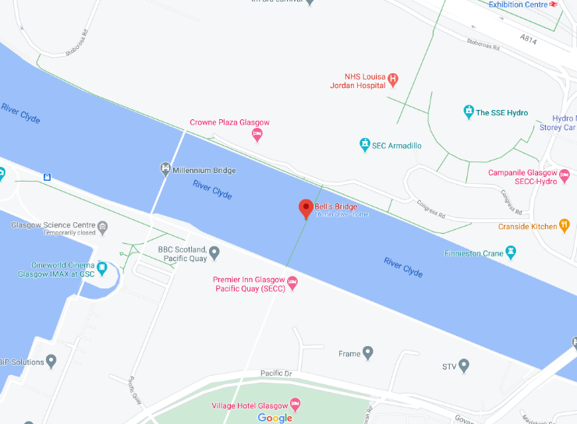
124 more cyclists using Bells Bridge during 2 day survey period in 2018 compared to same period in 2009.

Slide 115
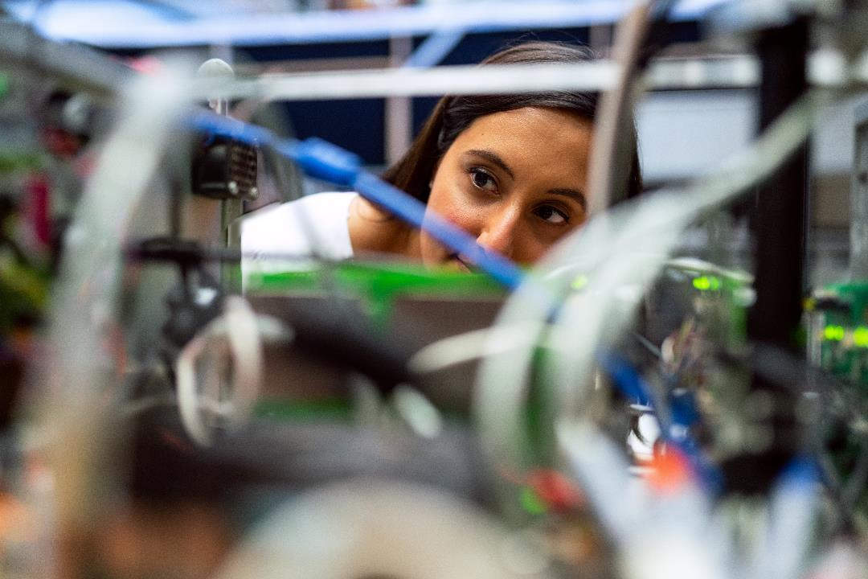
Notes:
What level of detail would an engineer want?
Photo by ThisIsEngineering from Pexels

Slide 116

Notes:
Would a visual artist be as interested in the same level of details and figures. Maybe, its context that matters .
Photo by Brett Sayles from Pexels

Slide 117

Personas
Notes:
https://dribbble.com/shots/1938508-Free-User-pics

Slide 118
“…nobody uses them…
why should we use them?”
Notes:
This might be something some people are thinking? You told about personas

Slide 119

Notes:
Some people think it’s a good idea, some do not lets look at which organisations use personas
https://www.pexels.com/photo/banking-business-checklist-commerce-416322/

Slide 120


Slide 121
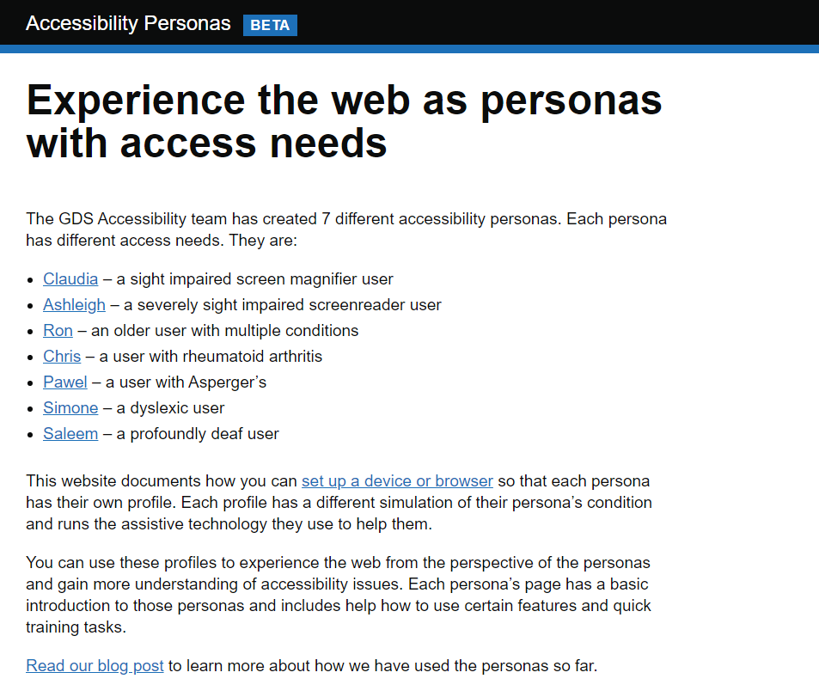
Notes:
https://alphagov.github.io/accessibility-personas/

Slide 122
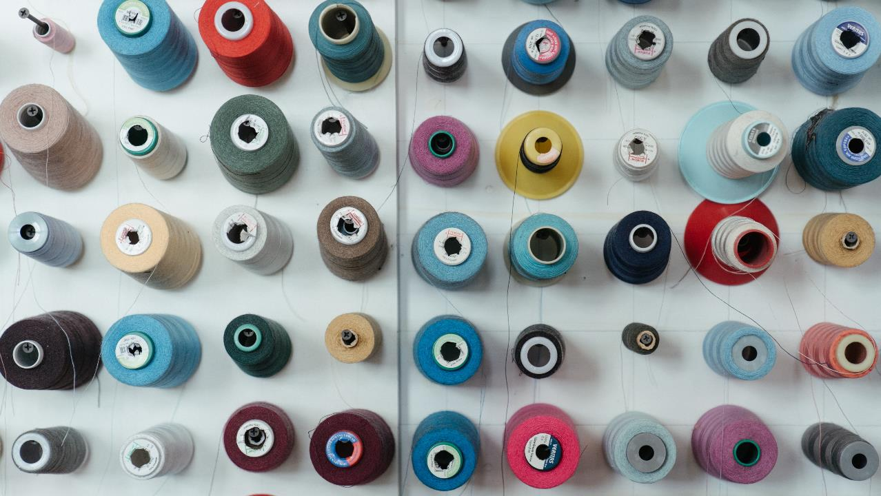
Define your audience?
Notes:
Many humans like to sort things into different categories
Photo by cottonbro from Pexels

Slide 123
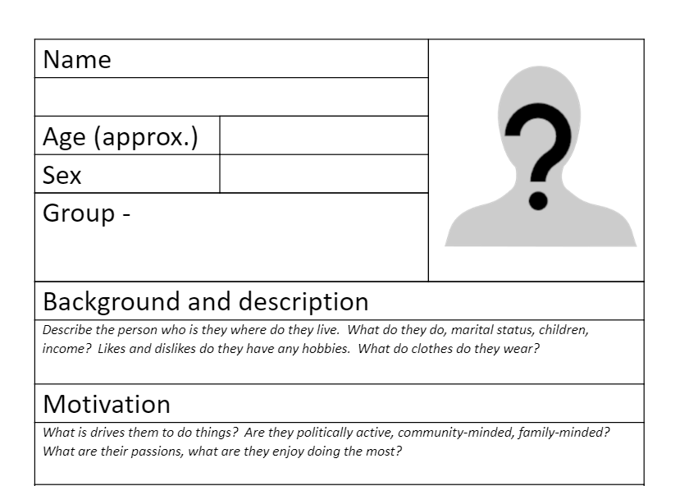

Slide 124
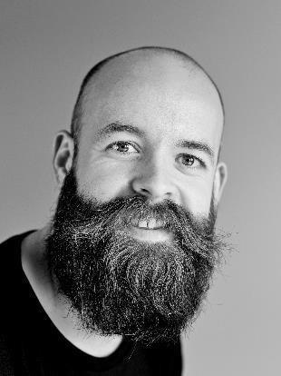


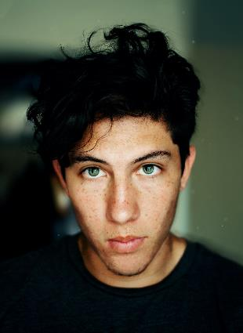

https://unsplash.com/s/photos/face
Notes:
Photo by Imansyah Muhamad Putera on Unsplash
Photo by Omid Armin on Unsplash
Photo by Erik Lucatero on Unsplash
Photo by Craig McKay on Unsplash

Slide 125

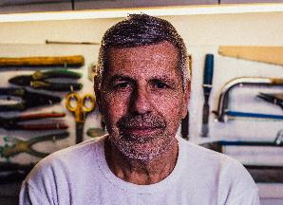
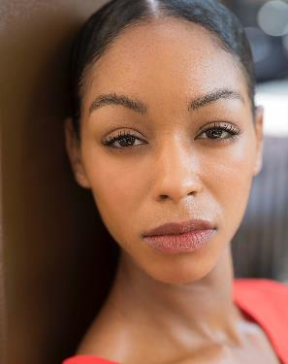

https://www.pexels.com/search/face/
Notes:
Photo by Italo Melo from Pexels
Photo by Juan Pablo Serrano Arenas from Pexels
Photo by SHAHBAZ AKRAM from Pexels
Photo by Moose Photos from Pexels

Slide 126
"Eat your own dog food"
“Show people that you do, what you tell other people to do……"

Slide 127

Don’t just talk the talk
Walk the Walk

Slide 128
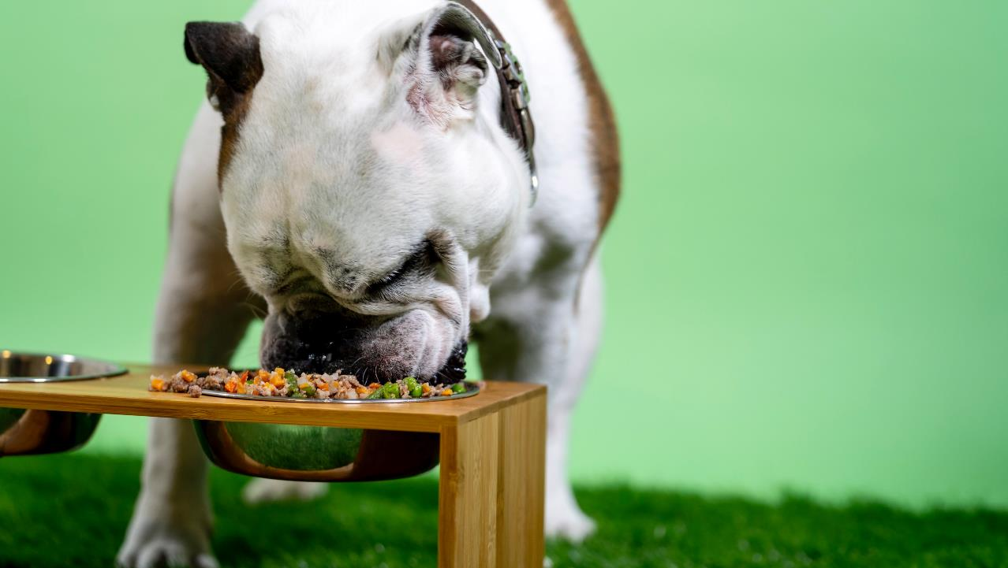
Notes:
Photo by Kabo on Unsplash
Yes I do eat my own dog food

Slide 129

Notes:
As in all the good cookery shows here’s is one I prepared earlier
Photo by Phinehas Adams on Unsplash

Slide 130
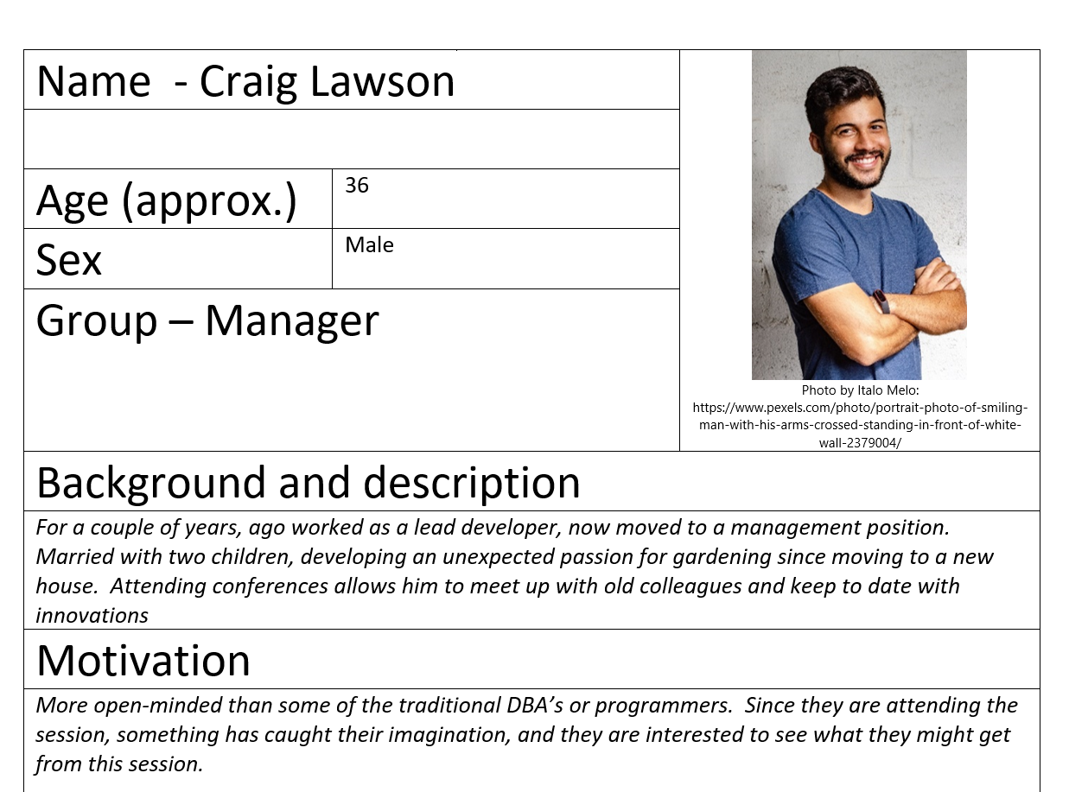

Slide 131
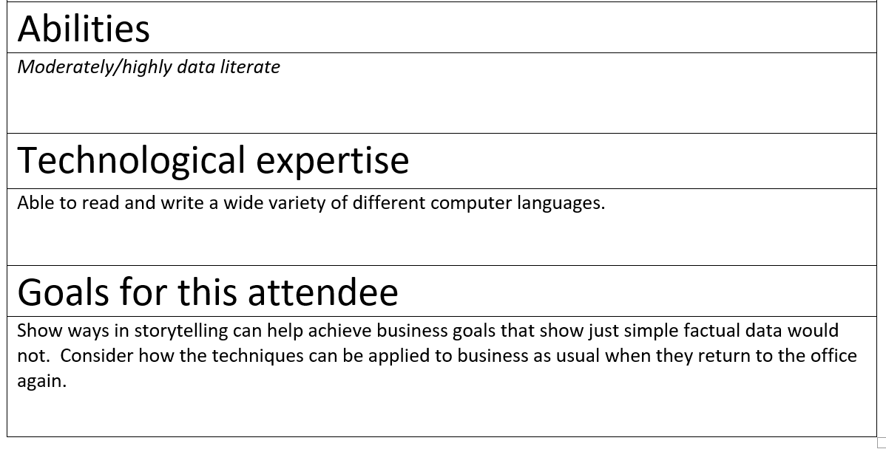

Slide 132
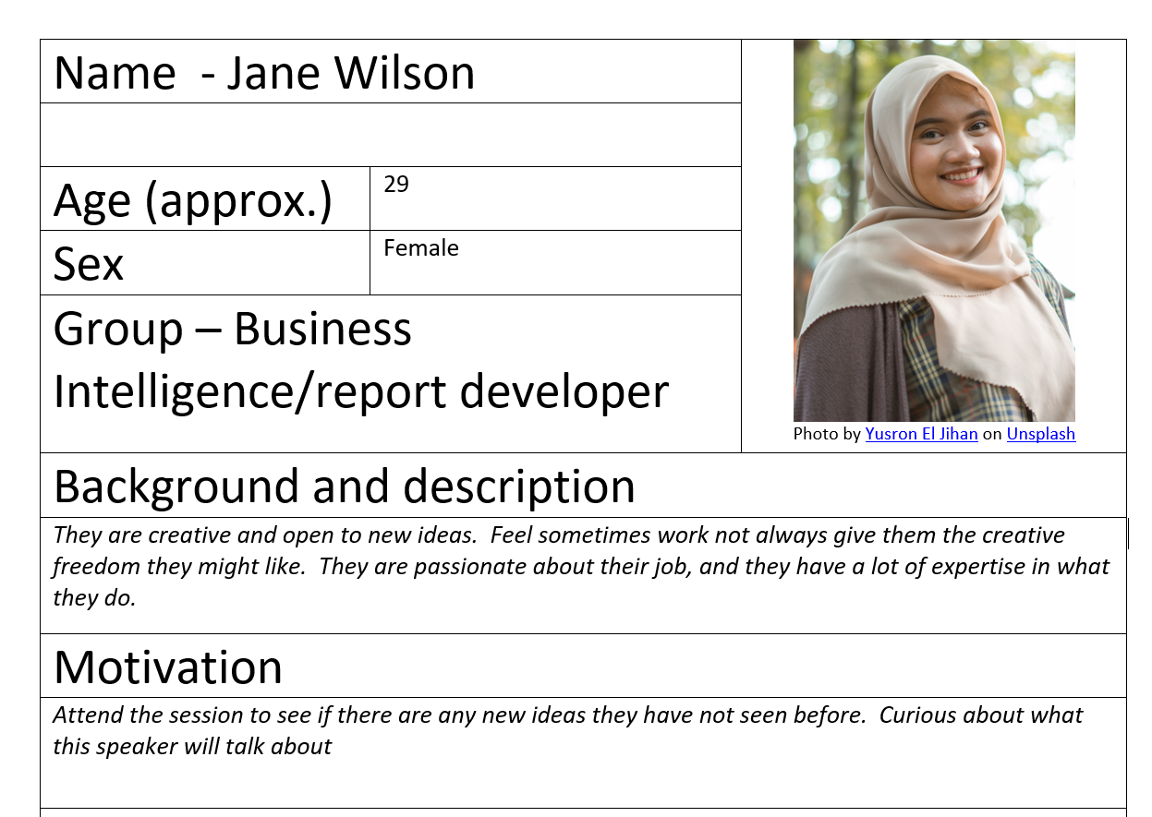

Slide 133
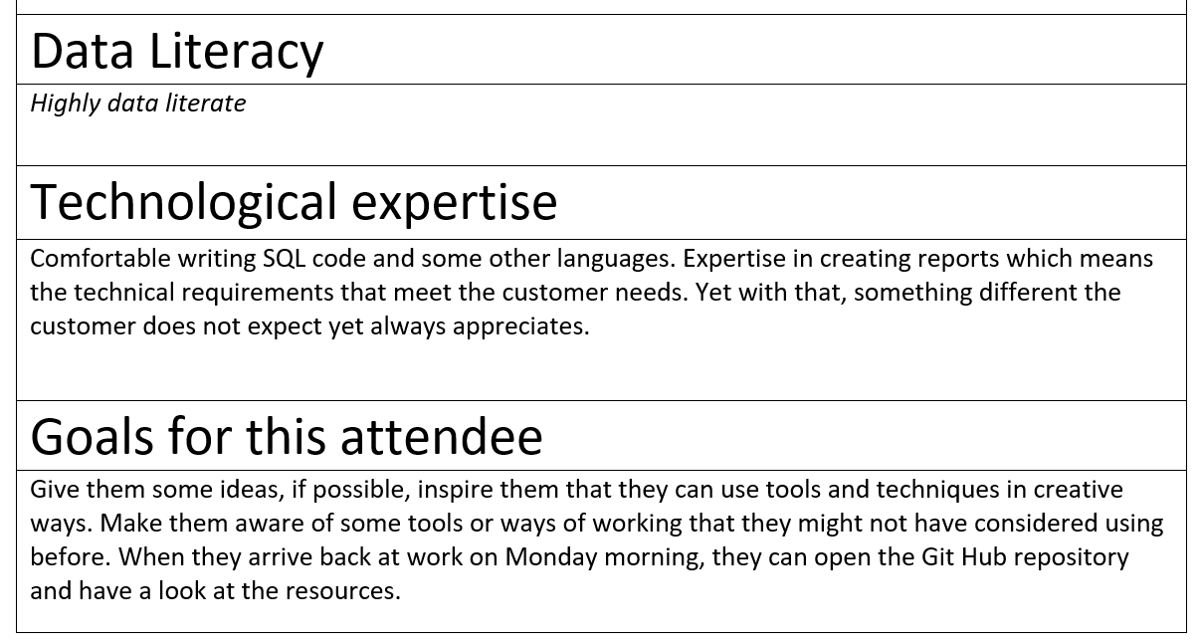

Slide 135
Notes:
Photo by Mika Baumeister on Unsplash
Data

Slide 136
Question
1) X + D = DX
2) X + D = XD
Hint X = 10 D = 500
https://www.romannumerals.org/converter

Slide 137


Slide 138
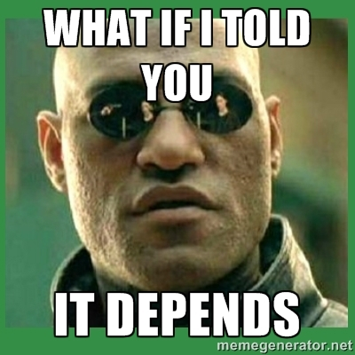

Slide 139
1) X + D = DX ü
10 + 500 = 510
2) “X” + “D” = “XD” ü

Slide 140

Notes:
Photo by Markus Spiske on Unsplash
We all know that computers will not allow an Integer to be added a string, yes you can one has to be converted

Slide 141

Notes:
Do you know your dataset as well as you know your bank account?
Photo by Karolina Grabowska from Pexels

Slide 142

Notes:
Photo by Tim Stief on Unsplash
Do you know simple things like the
lowest value and the highest value, what is the average value does that look right?
Bed blocking story – Jen Stirrup

Slide 143

Notes:
Photo by Florian Schmidinger on Unsplash
Not buy a house without a survey, or would you?

Slide 144

This Photo by Unknown Author is licensed under CC BY-NC-ND
Notes:
Yet make business decisions based on data you do not know?
Known unknowns

Slide 145

Notes:
Photo by Markus Spiske on Unsplash
Do not panic what are we suggesting?

Slide 146

Notes:
Photo by Pavan Trikutam on Unsplash
Are there obvious pattern's in the data

Slide 147
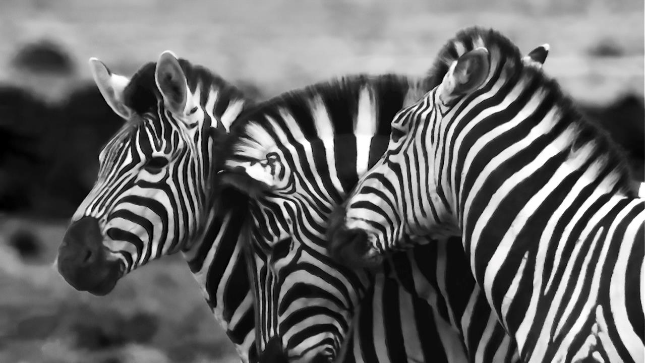
Notes:
Photo by Etienne Steenkamp on Unsplash
Do these patterns make sense if selling ice cream you expect to sell more when it is warmer, not in the winter, unless get a Christmas spike?

Slide 148

Notes:
Photo by Todd Diemer on Unsplash
Are there highs and lows in your data?
Can you see unexpectedly high or values which you cannot explain?

Slide 149

Notes:
Photo by Etienne Steenkamp on Unsplash
Are those “outliers” those bits off data to do not fit the ups and downs why are they so different do you know about them
These affect forecasts

Slide 150
Example questions to ask
Min
Max
Average
How many records
How much detail

Slide 151
Hierarchies
Year
Month
Day

Slide 152
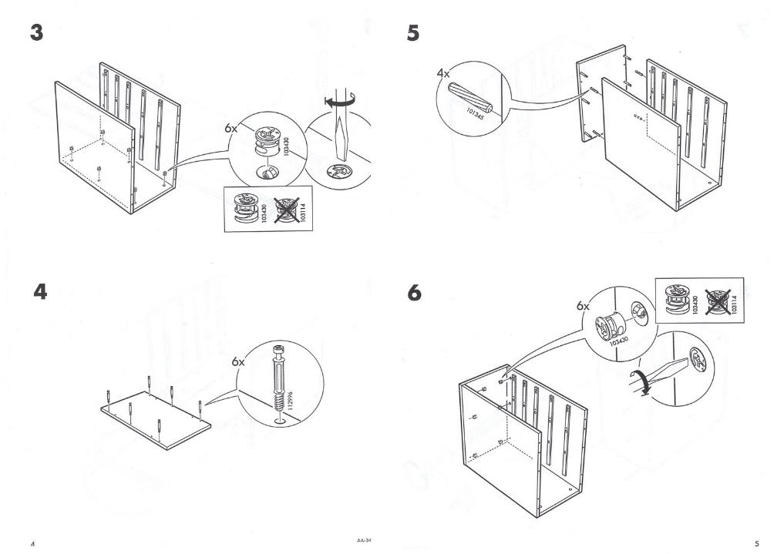
Notes:
How do you profile data?

Slide 153

Notes:
You can use Power BI

Slide 154

Is your data Quantitative?
Discrete – How many ducks in the pond in June 2021

Slide 155
Is your data Quantitative?
Continuous – What is the weight of all the ducks in the pond in June 2021

Slide 156
Is your data Qualitive or Categorical
Is your data Nominal, can it be ranked, is there any correlations…..

Slide 157
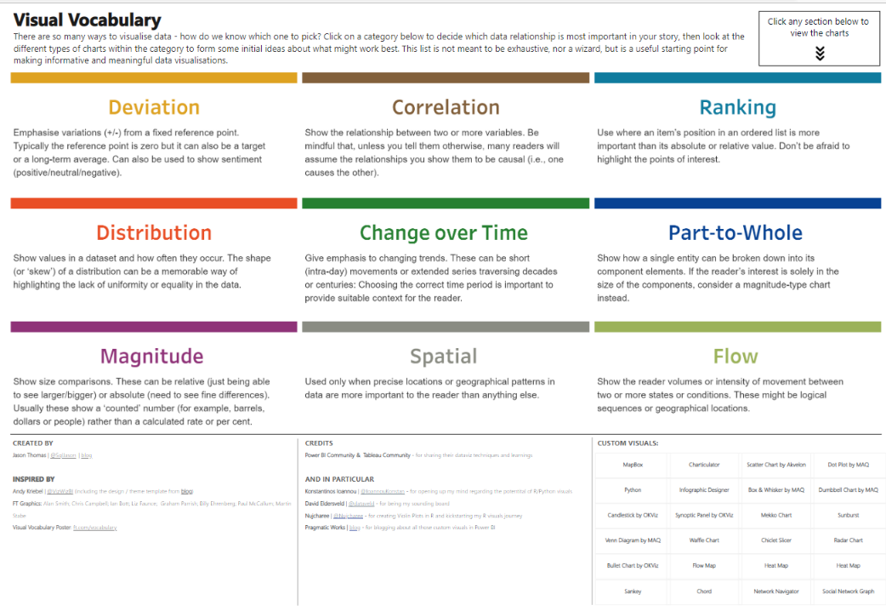

Slide 159
Notes:
Photo by Anna Shvets: https://www.pexels.com/photo/person-holding-silver-round-coins-4226264/
Look at how the brain works

Slide 160

Notes:
Its not easy to learn a new skill
Photo by The Ride Academy on Unsplash

Slide 161

Notes:
How to do we learn? – sometimes we feel there is so much to learn !
Photo by Tim Gouw on Unsplash

Slide 162
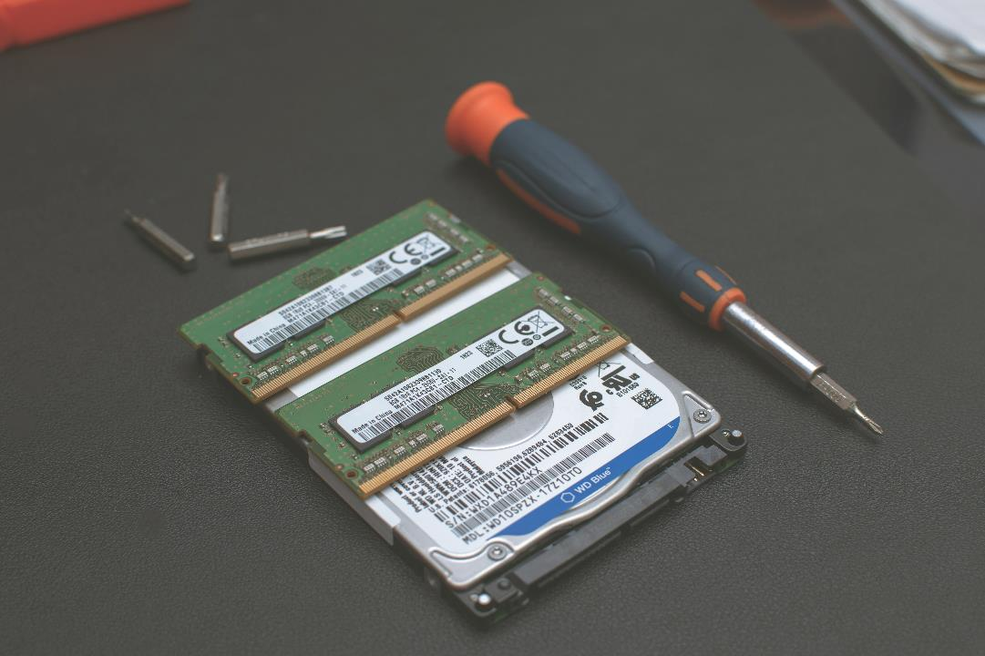
Notes:
Two types of memory
Photo by Heliberto Arias on Unsplash

Slide 163
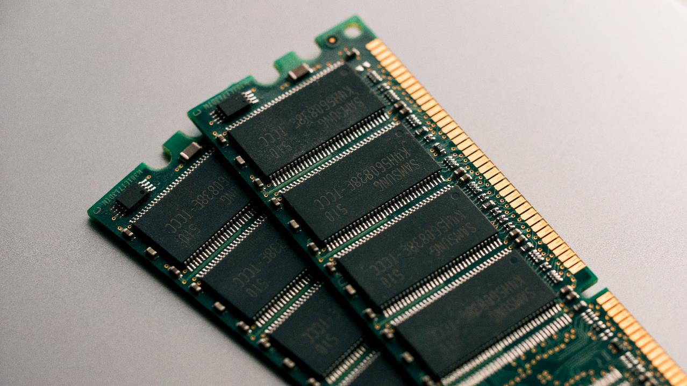
Notes:
Working memory - which is store term more of scratch pad more than anything
Photo by Harrison Broadbent on Unsplash

Slide 164

Notes:
Long term memory – which is where we store
Photo by Azamat Esenaliev from Pexels

Slide 165

Notes:
For the example we are going to assume three slots
Photo by Tony Hand on Unsplash

Slide 166
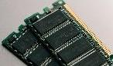

“Computer Ram”
Slot one
Slot two
Slot three
“Hard Drive”

Slide 167



“Working memory”
Slot one
Slot two
Slot three
“Long Term memory”

Slide 168
“Working memory”
Slot one
Slot two
Slot three
“Long Term memory”

Slide 169

“Working memory”
Slot one
Slot two
Slot three
“Long Term memory”

Slide 170

“Working memory”
Slot one
Slot two
Slot three
“Long Term memory”

Slide 171
“Working memory”
Slot one
Slot two
Slot three
“Long Term memory”

Slide 172


Slide 173

Fixation 1

Slide 174

Fixation 2

Slide 175

Fixation 3

Slide 176

Fixation 4

Slide 177


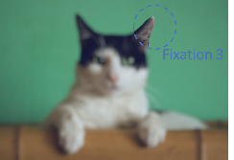


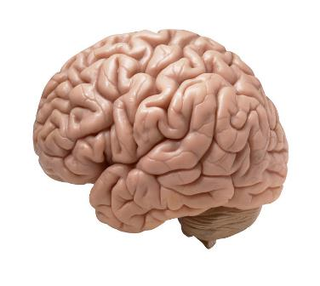

https://www.flickr.com/photos/flamephoenix1991/8376271918
Notes:
https://www.flickr.com/photos/flamephoenix1991/8376271918
We actually see with our brains and it does a lot of work to fool us

Slide 179

Notes:
Photo by Ann H: https://www.pexels.com/photo/letters-on-dice-15387083/
There’s more

Slide 180
And?
So what?
Notes:
Some might be saying this in their head

Slide 181
Z scanning

Slide 182





Slide 183
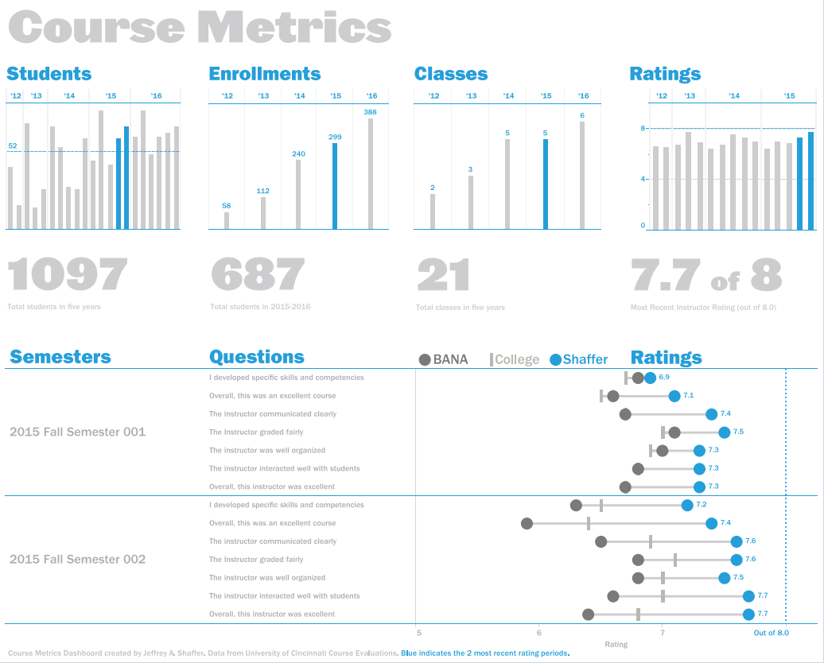

Slide 188
F
scanning

Slide 190

Notes:
Or thinking what has this got to do with data story telling
Photo by Robert Nagy from Pexels

Slide 191


Slide 192

Notes:
https://www.smashingmagazine.com/2016/09/reducing-cognitive-overload-for-a-better-user-experience/

Slide 193
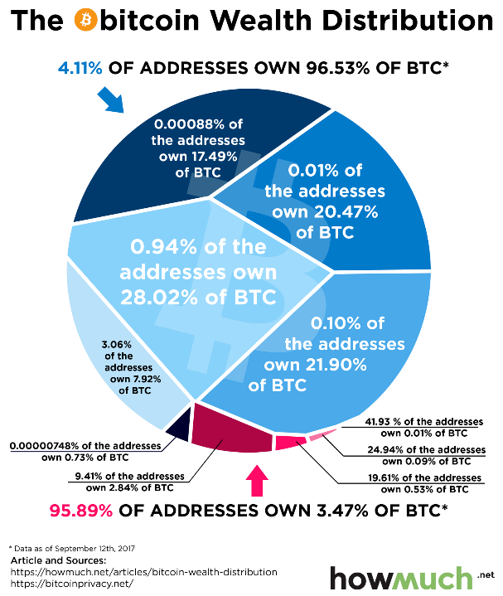

Slide 194
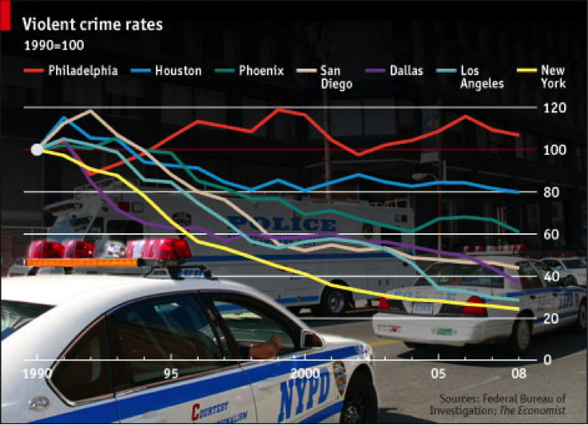
https://uxmag.com/articles/four-cognitive-design-guidelines-for-effective-information-dashboards
Notes:
https://uxmag.com/articles/four-cognitive-design-guidelines-for-effective-information-dashboards

Slide 195
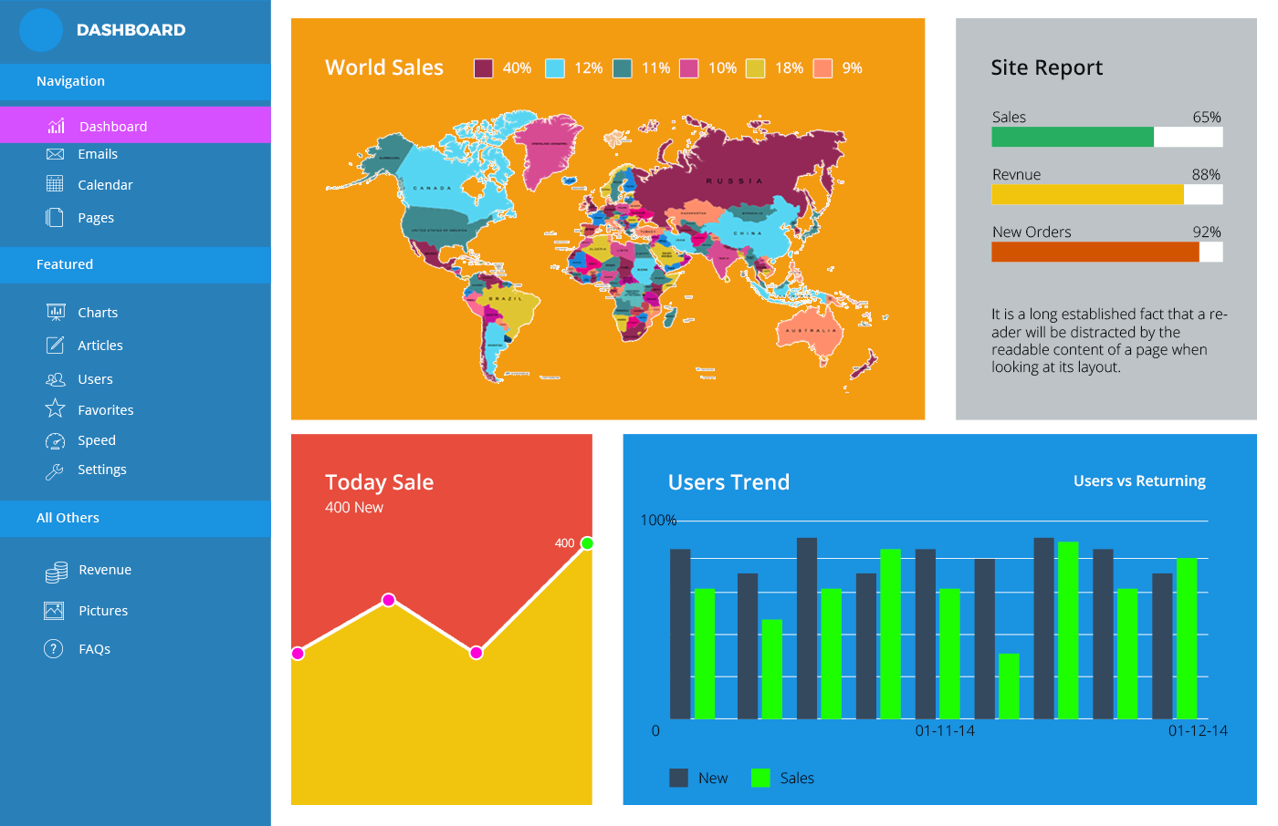
10 Dashboard Design Errors And How To Avoid Them (fusioncharts.com)10 Dashboard Design Errors And How To Avoid Them (fusioncharts.com)

Slide 196


Slide 197

There are only THREE slots in my working memory
Notes:
Photo by Atul Choudhary from Pexels

Slide 198
Notes:
Tell the story how created these photos

Slide 199

Notes:
Photo by Markus Winkler on Unsplash
How can be communicate to data to our users using data visualisations

Slide 200

Notes:
Image by Brett Hondow from Pixabay

Slide 201
Preattentive Attributes
Notes:
Image by Brett Hondow from Pixabay

Slide 202

Notes:
Photo by wu yi on Unsplash
Test time going to time you to see how long it takes to complete this task

Slide 203
1 | 3 | 9 | 3 | 3 | 7 | 7 | 0 | 1 | 9 | 7 | 5 | 5
9 | 5 | 0 | 3 | 1 | 3 | 2 | 0 | 3 | 3 | 7 | 8 | 9
3 | 3 | 1 | 7 | 9 | 5 | 5 | 0 | 5 | 1 | 5 | 9 | 6
5 | 2 | 4 | 8 | 2 | 3 | 4 | 5 | 6 | 3 | 5 | 1 | 9
7 | 0 | 1 | 3 | 1 | 0 | 1 | 3 | 2 | 1 | 7 | 3 | 4
1 | 9 | 4 | 9 | 3 | 1 | 5 | 2 | 4 | 1 | 3 | 1 | 9
3 | 5 | 0 | 8 | 4 | 8 | 2 | 6 | 8 | 8 | 5 | 2 | 2
3 | 1 | 5 | 1 | 5 | 3 | 9 | 1 | 0 | 1 | 7 | 9 | 5
3 | 3 | 3 | 6 | 1 | 7 | 0 | 1 | 2 | 7 | 1 | 3 | 0
Notes:
12 nines

Slide 204

Notes:
Photo by Nguyen Dang Hoang Nhu on Unsplash
Did that feel like a test?

Slide 205
1 | 3 | 9 | 3 | 3 | 7 | 7 | 0 | 9 | 1 | 7 | 5 | 5 | 8
9 | 5 | 0 | 3 | 1 | 3 | 2 | 0 | 3 | 3 | 7 | 8 | 9 | 2
3 | 3 | 1 | 7 | 9 | 5 | 5 | 0 | 5 | 1 | 5 | 3 | 6 | 4
5 | 2 | 4 | 8 | 2 | 3 | 4 | 5 | 6 | 9 | 5 | 1 | 5 | 4
7 | 0 | 1 | 9 | 1 | 0 | 1 | 3 | 2 | 1 | 7 | 3 | 4 | 4
1 | 5 | 4 | 3 | 3 | 1 | 5 | 2 | 4 | 1 | 3 | 1 | 8 | 9
3 | 5 | 0 | 8 | 4 | 8 | 2 | 6 | 8 | 8 | 5 | 2 | 2 | 5
3 | 1 | 5 | 9 | 5 | 3 | 1 | 1 | 0 | 1 | 7 | 6 | 5 | 0
9 | 3 | 1 | 1 | 0 | 5 | 5 | 0 | 6 | 5 | 1 | 7 | 1 | 9
2 | 5 | 3 | 0 | 1 | 8 | 1 | 2 | 9 | 3 | 1 | 3 | 2 | 4
Notes:
12 nines

Slide 206

Notes:
Photo by Ben White on Unsplash
Did that version seem easier?
No the nines where not all in the same place ;-)

Slide 207

Notes:
Some of you have questions
Why is he doing this?
Why did the colour make it much easier

Slide 208

Notes:
Colin Ware in his book Information visualisation for design

Slide 209
Form

Slide 210
Length

Slide 211
Width

Slide 212
Orientation

Slide 213
Curvature

Slide 214
Size

Slide 215
Shape

Slide 216
Added Marks

Slide 217
Enclosure

Slide 218
Blur

Slide 219
Spatial Grouping

Slide 220
Colour

Slide 221
Hue

Slide 222
Intensity

Slide 223
Spatial
Position

Slide 224
2D Position

Slide 225
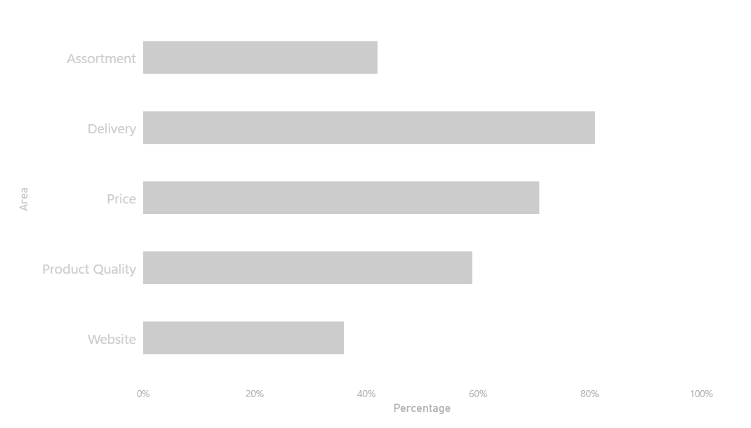
Website survey results
Notes:
Here is some website survey results

Slide 226
What are the best performers?

Slide 227
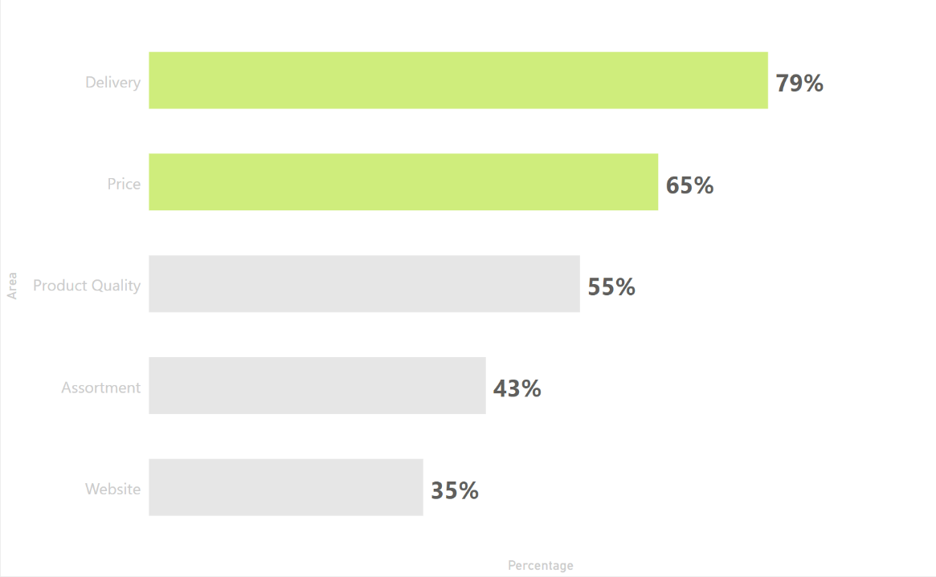
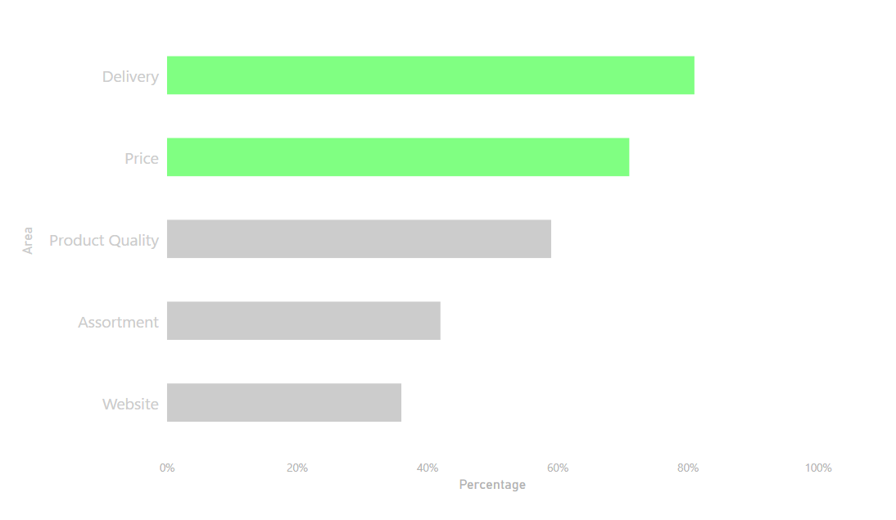

Slide 228
What are the worst performers?

Slide 229
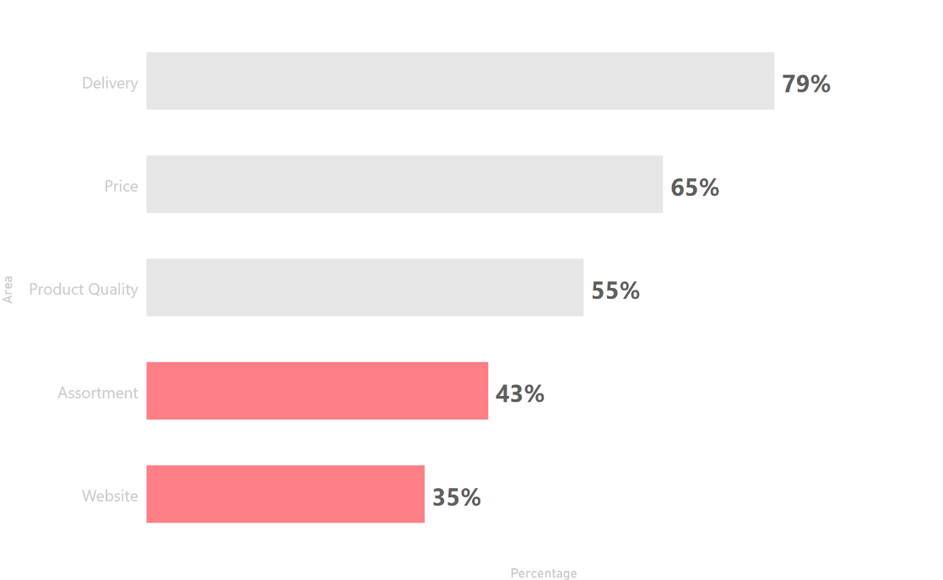

Slide 231
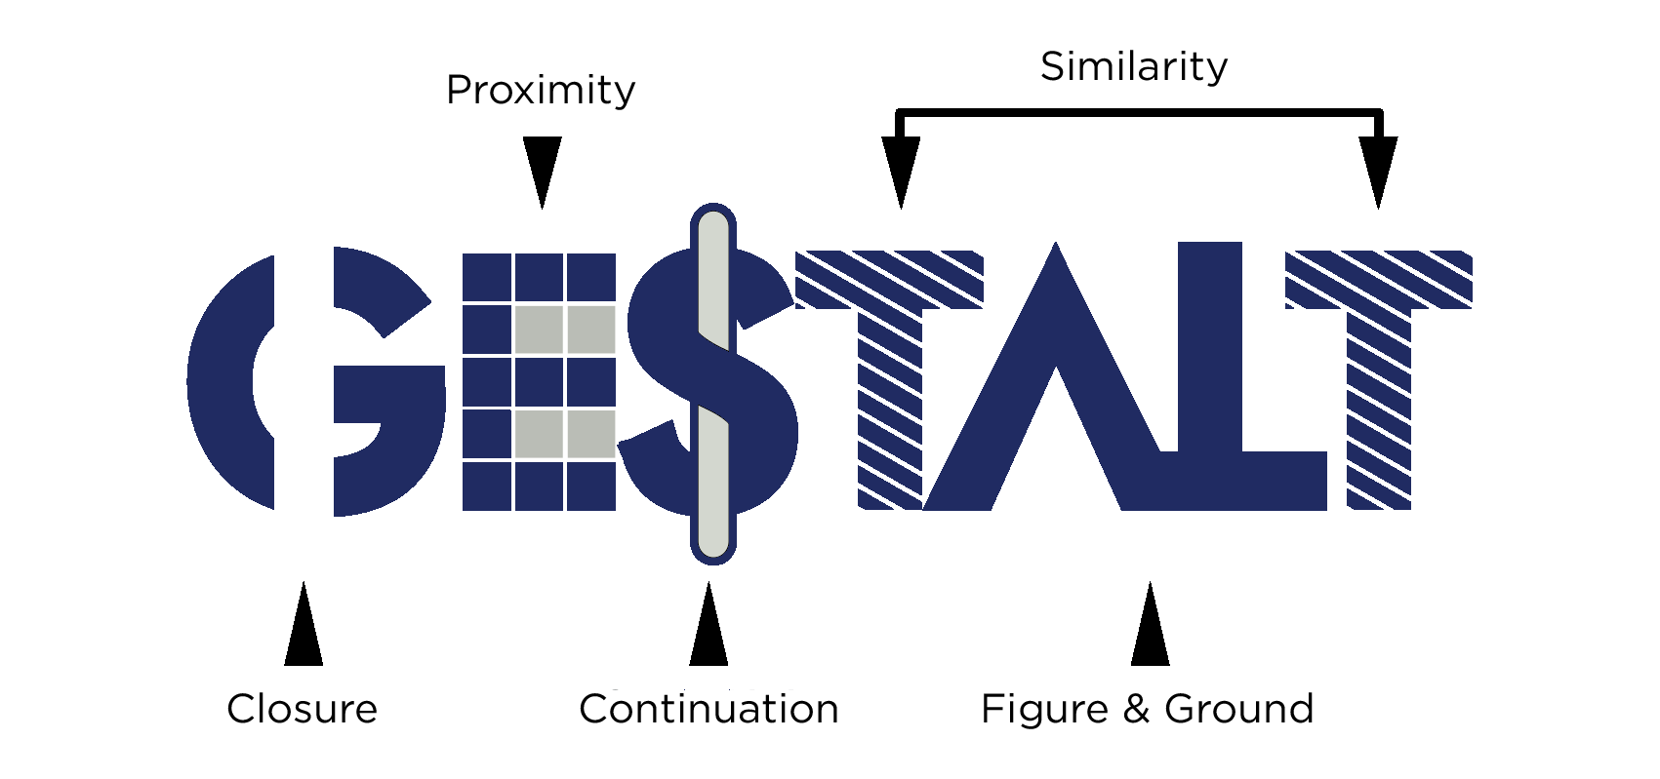
Gestalt principles

Slide 233
Proximity

Slide 235
Symmetry

Slide 237
Similarity

Slide 239
Enclosure

Slide 241
Closure

Slide 243
Continuity

Slide 245

Similarity

Slide 246

Anomaly

Slide 247


Slide 248

Notes:
Photo by Nick Fewings on Unsplash

Slide 249

Closure
Notes:
Lets look at some real life

Slide 250
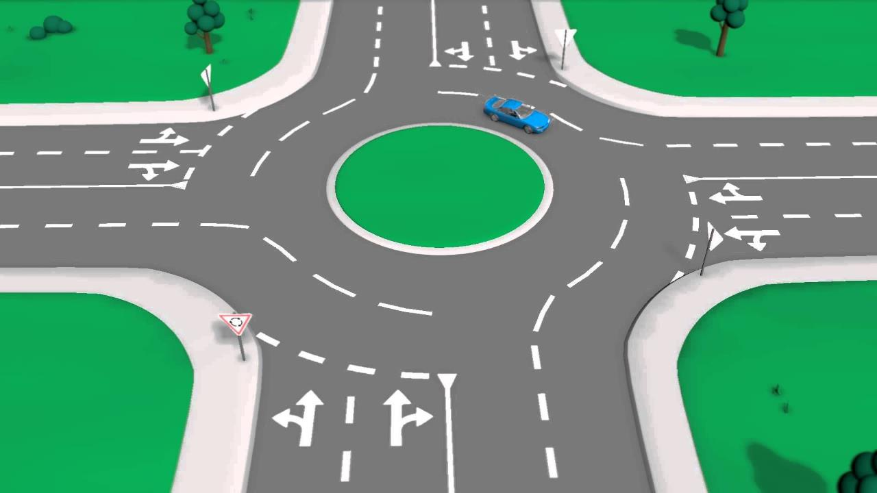
Closure
Notes:
Even though the lines are dashed we see them as a whole
Forming a T shape
Showing way around the roundabout

Slide 251

Continuation
Notes:
Your eye is drawn form the A to Z and them along the logo

Slide 252

Continuation

Slide 253

Figure and ground
By Bryan Derksen - Original image Cup or faces paradox.jpg uploaded by Guam on 28 July 2005, SVG conversion by Bryan Derksen, CC BY-SA 3.0, https://commons.wikimedia.org/w/index.php?curid=1733355
Notes:
Vase or two faces?
By Bryan Derksen - Original image Cup or faces paradox.jpg uploaded by Guam on 28 July 2005, SVG conversion by Bryan Derksen, CC BY-SA 3.0, https://commons.wikimedia.org/w/index.php?curid=1733355

Slide 254
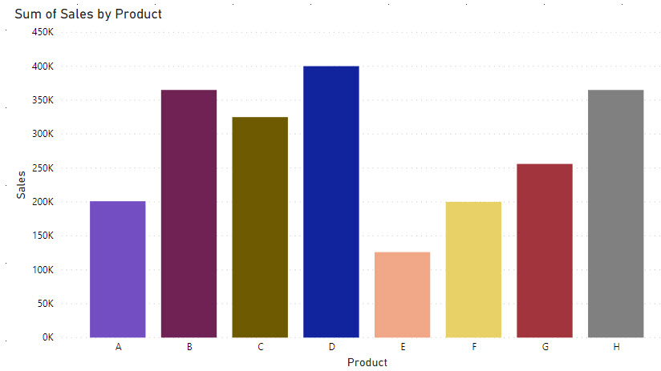
Notes:
this chart is not following the Gestalt Principle of Continuity

Slide 255
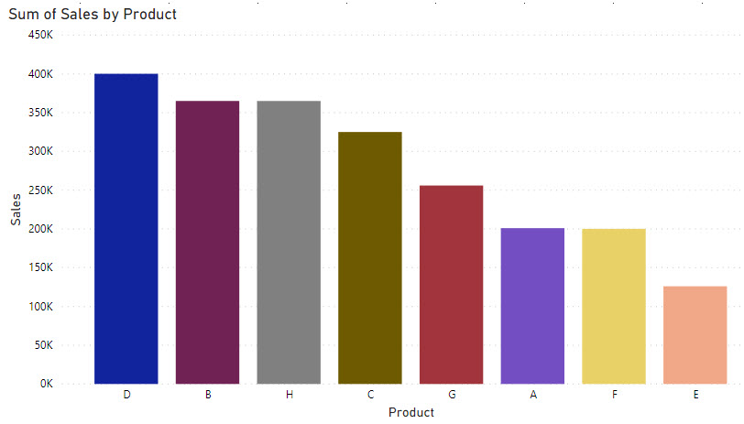
Notes:
Chart rearranged to better follow the Gestalt Principle of Continuity / Continuatoin

Slide 256

Notes:
Chart rearranged to follow the Gestalt Principles of Continuity and Similarity

Slide 257


Slide 258


Number of male vs female employees
Notes:
Similarity

Slide 259


Employees born in UK vs born elsewhere
Notes:
Similarity
Note that there a several levels to this report with are easy to see without being obvious
What are they?

Slide 260

Notes:
Photo by Andrea Piacquadio: https://www.pexels.com/photo/tired-female-student-lying-on-book-in-library-3808080/
Some of you might be thinking nobody uses these techniques in real life

Slide 261


Slide 262

Notes:
Photo by Andrew Neel: https://www.pexels.com/photo/white-flag-2330507/

Slide 263


Slide 264


Slide 265


Slide 266


Slide 267


Slide 268

Notes:
Photo by That's Her Business on Unsplash

Slide 269

Homework
https://youtu.be/hVimVzgtD6w
Notes:
https://youtu.be/hVimVzgtD6w
2:35

Slide 270
Notes:
Photo by Andrea Piacquadio from Pexels

Slide 271

Notes:
image by <a href="http://www.freeimageslive.co.uk/free_stock_image/typographyjpg" target="_blank"> freeimageslive.co.uk - creator</a>

Slide 272
How does font this feel?

Slide 273
How does this font feel?

Slide 274
How does this font feel?

Slide 275
How does this font feel?

Slide 277
Is this easy to read?

Slide 278
Is this easy to read?

Slide 279
Is this easy to read?

Slide 280
Is this easy to read?

Slide 281
Is this easy to read?

Slide 283

Girls in white dresses with blue sashes
Bright copper kettles and
warm woollen mittens
Cream coloured ponies and crisp apple strudels

Slide 284
Colours can have emotions associated with them.

Slide 285
Passion, Love, Blood, Danger, Strength
Romantic, Feminine, Love, Sensitivity, Exciting
Optimism, Sunshine, Confidence, Attention, Success
Health, Growth, Peace, Vitality, Wealth
Energy, Happiness, Success, Warmth, Creativity
Trust, Serenity, Peace, Communication, Sadness
Royalty, Majesty, Mystery, Spirituality, Luxury
Organic, Honest, Natural, Simple, Wholesome
Compromise, Neutral, Balance, Conservative, Frustration
Elegance, Power, Luxury, Mystery, Sorrow
Pure, Simple, Innocence, Virginity, Minimalism

Slide 286
Colours can suggest temperatures.

Slide 287

Notes:
Some colours can have feelings of temperature associated with them
https://choelscherart.com/wp-content/uploads/Color-Wheel-basic.jpg

Slide 288
Choose colours carefully

Slide 289

Notes:
We need to choose carefully what colours we are going to use
Photo by Victoriano Izquierdo on Unsplash

Slide 290

Context of the colour is key.

Slide 291

Notes:
Red is good that’s the cool of oxygenated blood
Pink cheeks and rosey skin means you are warm and comfortable
Photo by Karolina Grabowska from Pexels

Slide 292
Green skin is not sign of good health

Slide 293

Notes:
The Ultimate Guide To Virtual Trading And Stock Market Simulators | Bankrate

Slide 294

Notes:
https://globalvoices.org/2015/07/13/the-risky-roller-coaster-ride-that-is-chinas-stock-market/
https://www.bbc.co.uk/news/av/business-33464903
“China's stock markets explained in 50 seconds. Why, on Chinese share price display screens, does red mean that a share's price has gone up, rather than down, as it does in other countries where green means that a share price has risen?”

Slide 295

Notes:
https://slate.com/business/2014/11/japan-is-in-a-recession-why-is-its-unemployment-so-low.html

Slide 297

Notes:
Photo by Yan Krukov: https://www.pexels.com/photo/group-of-people-doing-fist-bump-7793141/
Stories work

Slide 298

Notes:
Photo by Sharon McCutcheon on Unsplash
Story got me a 25% pay rise in one job

Slide 299

Notes:
Photo by Tima Miroshnichenko: https://www.pexels.com/photo/businessman-looking-at-employee-5439368/
Stories that I have ready for job interviews

Slide 300

Notes:
https://app.powerbi.com/view?r=eyJrIjoiY2VlMjg1MmQtMzFhZi00NzY1LThjZTUtMWI2MjM5ODFhYjUzIiwidCI6ImJkNjlkMzZiLTE3ZGQtNDczZC05MWM2LWNlYzI4ODI5YWI1MyIsImMiOjh9
We created a story about potholes to pitch for a data story telling workshop

Slide 301

Notes:
Photo by toine G on Unsplash
The stories about improving SQL Server speed performance

Slide 302

Notes:
Photo by Brett Jordan on Unsplash
It requires work to learn how to tell stories and create amazing data stories

Slide 303

Notes:
Photo by John Arano on Unsplash
You need to practice, practice, practice and rehearse

Slide 304

Notes:
Photo by the blowup on Unsplash
Then try again and try again and try again

Slide 305
Robert French
Chief Power BI Nerd at Quorum
Lives in Sunny Glasgow, Scotland
rwlp.french@gmail.com
@sqlbobscot
https://www.linkedin.com/in/rwlpfrench/
https://www.qnrl.com/

